Slide 1
Performance Measurement
Chapter 5

Slide 2
Overview
Module 5.1: Basic Performance Measurement Concepts
Module 5.2: Performance Rating – Substance
Module 5.3: Performance Rating – Process
Module 5.4: Social & Legal Context

Slide 3
Module 5.1: Basic Performance Measurement Concepts

Slide 4
Uses of Performance Information
Criterion Data
Employee development
Motivation
Rewards
Transfer
Promotion
Termination

Slide 5
Types of Measures & Interrelationships
______________________ measures
Sales data
Electronic performance monitoring
______________________ measures
Supervisor ratings
Hands-on performance measure
Could be classified as objective but eliminates some contaminating influences of objective measures (e.g., inadequate equipment, interrupting coworkers)

Slide 6
Performance Management vs. Performance appraisal
Emphasizes link between individual behavior & organizational strategies & goals
Components
Definition of performance
Actual measurement process
Communication between supervisor & subordinate about individual behavior & organ. expectations

Slide 7
Performance Appraisal vs. Performance Management
PA
PM
Rare (e.g., once a year)
Initiated by HR
Developed by HR and given to managers
Feedback is rare (e.g., once a year)
Nonstrategic
Focus on evaluation
More frequent
Initiated by HR, manager, subordinate
Developed by managers and subordinates
Ongoing feedback
Strategic
Focus on understanding strategic performance criteria and behavior fit

Slide 8
Why Worry About Formal Appraisal?
Helps people recognize how to do their jobs better
Identifies unknown selection and training needs
Rewards good performance and identify failures that are “untrainable” or not cost effective
Maintains fairness in salaries, benefits, hiring, firing
Protects against charges of discrimination

Slide 9
Module 5.2: Performance Rating – Substance

Slide 10
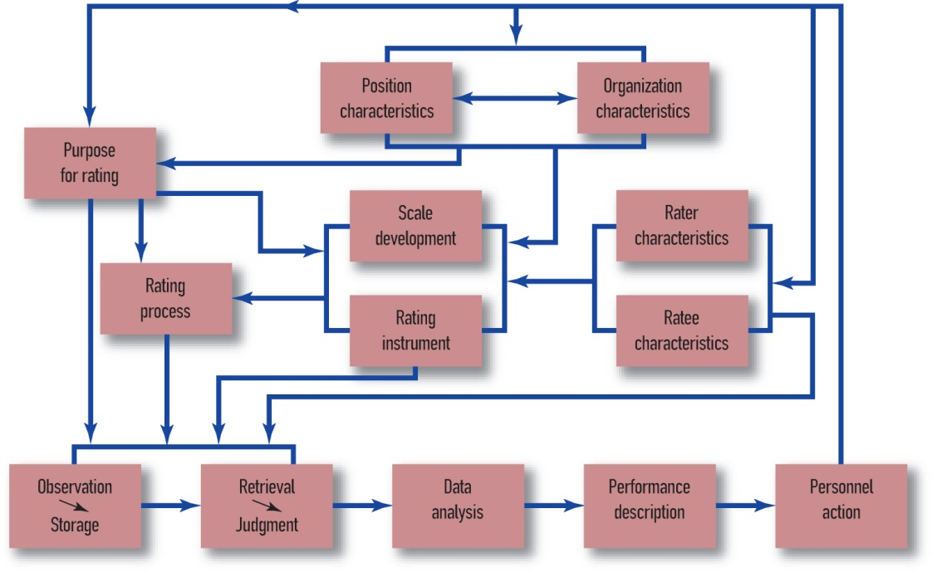
Process Model of Performance Rating
SOURCE: Landy & Farr (1980).
Notes:
Array of possible influences points out complexity of performance rating process.

Slide 11
Types of Ratings
______________________
Influenced by
Task performance
OCBs
CWBs
Use driven by desire for simplicity, using for administrative purposes
Practically not useful – no conceptual meaning

Slide 12
Types of Ratings
Trait Ratings = ______!
Not actions or behaviors
Not defensible
Task-Based Ratings & Critical Incidents = ______!
Typically supervisors rate tasks on scale anchored by critical incidents

Slide 13
Rating Scales
Graphic Rating Scales
Graphically display performance scores running from high to low
Most common
Checklists & Weighted Checklists
List of behaviors presented to rater who places a check next to items that best (or least) describe the ratee
Weighted checklists assign value to each task
Forced-choice – requires rater to choose specified number of statements that apply to ratee
Good for easy generation of score; bad for feedback

Slide 14
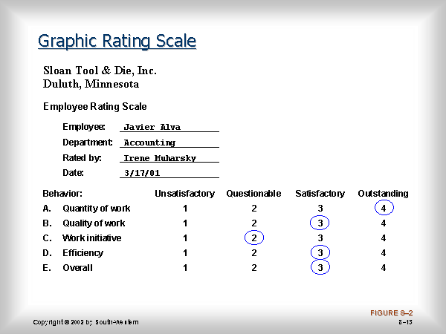
Notes:
http://www.cengage.com/management/pierce/ch08/sld013.htm

Slide 15
Rating Scales
Behaviorally Anchored Rating Scales
Includes behavioral anchors describing what worker has done, or is expected to do, in a particular duty area
Time consuming to create
Increased perceptions of fairness & good for feedback

Slide 16
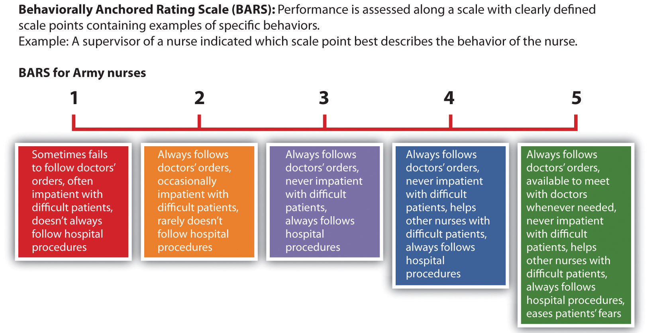

Slide 17
Rating Scales
Behavioral Observation Scales (BOS)
Response scale based on frequency (e.g., “almost never” to “almost always”)
Idea was that this would be more objective, and easier for the rater
Mixed findings regarding managers ability to recall frequencies.
Tziner and Kopelman (2002) – BOS was most preferred method by raters

Slide 18
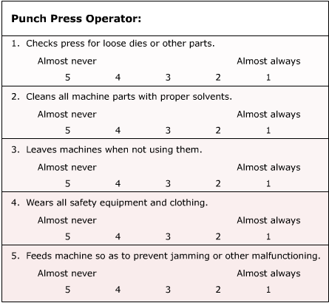
Notes:
https://dlc.erieri.com/index.cfm?fuseaction=textbook.chpt14

Slide 19
Comparison Methods
Types of Comparison
Simple ranking
Employees ranked from top to bottom according to assessed proficiency
Paired comparison
Each employee in a group is compared with each other individual in the group
Not good for large groups – # of comparisons = n(n-1)/2
Good for termination decisions; bad for feedback or performance management
Difficult to compare across groups

Slide 20
Module 5.3: Performance Rating – Process

Slide 21
Who Conducts Appraisal?
Supervisors (most common)
Peers
Self
Subordinate
Customers (if directly related to performance)
Consultants
Appropriate source depends on the purpose of the appraisal

Slide 22
Agreement Between Sources
Between… | r
Two supervisors | .50
Two peers | .37
Two subordinates | .30
Supervisors and peers | .34
Supervisors and subordinates | .22
Supervisor and self | .22
Peers and subordinates | .22
Peers and self | .19

Slide 23
360 Degree Appraisal
Collect & provide an employee with feedback that comes from many sources
Often used for employee development
Issues
Sources of Variability
Event rather than a process
Validity
Related to assessment center ratings
Related to supervisory performance evaluations

Slide 24
Feedback
Kluger & DeNisi’s (1996) meta-analysis
Across 23,000 participants, the average improvement due to feedback is d = 0.41
One third of the time, feedback decreased performance
Why?
Specificity
Accuracy
Timeliness
Negativity/Constructive Criticism

Slide 25
Feedback
Employee more likely to accept negative feedback if he/she believes:
Supervisor has sufficient “sample” of subordinate’s actual behavior
Supervisor & subordinate agree on subordinate’s job duties
Supervisor & subordinate agree on definition of good & poor performance
Supervisor focuses on ways to improve performance
“Praise-criticism-praise sandwich”

Slide 26
Rating Distortions (Errors?)
______ – rater assigns the same rating to a ratee on a series of dimensions
____________ – rater provides generally high scores across dimensions
__________ – rater provides generally low scores across dimensions
____________________ – raters marks the midpoint of a scale on a series of dimensions

Slide 27
Sources of Rater Error & The Social Context
Rater personality
Rater mood
Rater motivation
Race/Gender/Similarity
Managers’ fear of reactions to negative feedback
Opportunity to observe
Goal of appraisal process
Political factors?

Slide 28
Minimizing Rater Error
Use well-defined behavioral anchors
Train raters?

Slide 29
Rater Error (Psychometric) Training
Premise
Raters can avoid common rater errors if they are aware of them.
Does reduce halo.
Does not increase accuracy.
May actually harm accuracy

Slide 30
Performance Dimension Training
Premise
Raters can better identify dimensions if they are trained on what behaviors they involve.
We make judgments as behaviors occur.
If we put judgments into categories as we observe the behavior, halo might be reduced.
Does reduce halo
Does not improve leniency/severity
Does improve accuracy, slightly

Slide 31
Frame of Reference Training
Premise
Raters can be more consistent if they calibrate their understanding of the scales.
Does improve accuracy
Does not improve halo

Slide 32
Observational Accuracy Training
Aim is to improve memory of job performance incidents.
Keep records of “key” events
Diary or PDA
Does improve accuracy
Does not reduce halo

Slide 33
Accuracy vs. Error
Does halo matter if the ratings are accurate?
Is halo error?
Are other distortions errors?

Slide 34
Reliability & Validity of Performance Ratings
Reliability
Currently the subject of lively debate
Inter-rater reliability considered poor but this isn’t necessarily bad considering each rater relies on a different perspective
Validity
Depends on manner by which rating scales were conceived & developed

Slide 35
Module 5.4: Social & Legal Context

Slide 36
Motivation to rate
PA/PM process as a means to an end, either personal or organizational
Performance appraisal as a goal-directed activity with at least 3 stakeholders
Rater Goals
Task performance
Interpersonal
Strategic
Internalized
Ratee Goals
Information gathering
Information dissemination
Organizational Goals
Between-person uses
Within-person uses
Systems-maintenance

Slide 37
Goal Conflict
When single system is used to satisfy multiple goals from different stakeholders, rater must choose which goal to satisfy before assigning a rating
Possible solutions
Use multiple performance evaluation systems
Obtain involvement of stakeholders in developing the system
Reward supervisors for accurate ratings

Slide 38
Performance Evaluation & the Law
Ford Motor Company & forced distribution rating system
Evaluators were required to place managers into performance categories based on predetermined percentages (10%, 80%, 10%)
Ford paid $10.5 million to litigants
Werner & Bolino’s (1997) review of court cases
Analyzed 295 cases from 1980-1995
Judges primarily concerned with issues of fairness rather than technical characteristics of the system

Slide 39
Best Practices
Standardized and uniform – based on JA
Formally communicated
Provide prompt notice of performance deficiencies
Opportunities to correct
Employees should have access to their reviews
Provide methods to contest
Use multiple, diverse, unbiased raters who receive written instructions
Require thorough, consistent documentation
System to detect discriminatory effects
Performance management systems

